Slide 1
Chapter 3
Goal Modeling
Business goals motivate the design of processes, roles, responsibilities. Goals ultimately motivate choice of software architecture.
This chapter introduces techniques for modeling business goals, obstacles, and stakeholders.
It covers:
Goals
Obstacles
Responsibilities
Processes

Slide 2
Outline
What is the Motivation for “Goals”?
Goals Modeling and Refinement
From Goals to Responsibilities, Processes and Actions
Obstacles and Conflicts
Soft Goals
“List” and “Draft” versions of goals models

Slide 3





Outside (Goal), Boundary (Spec), and Inside (Design)
Weather Stations
The ‘Machine’
Connections
Software
spec
Weather
Sensors
Electronics
The Software
Goal / Requirement:
Keep Watchers informed
of Current Weather
Further “Outside”
UI
Internal
Design
Watchers
A domain is a part of the world with some shared state or interactions with other domains
  Weather, weather stations, watchers, the machine
Problem domain is different from Machine domain and intermediate “connection” domains
  The problem to be solved may be outside the machine; the machine + connections help solve it
Goals (objectives, outcomes) define what the machine must cause in the Problem domain
  It is expressed in terms of all relevant aspects of the problem domain(s): weather, watchers
Software Specification defines all interfaces of the software, including technical and UI
  It is a part of the solution, when combined with other domains and human operating procedures

Slide 4

Motivating Goals
Effectively manage Portfolio of Projects and Programs
High Level Goals
What is the goal or objective of the business i.e. Why have a computer application? Who cares about it?
??
Business goals are not the same as application software interface specifications, or even business processes or use cases
Low level
requirements
How must a computer application behave?

Slide 5


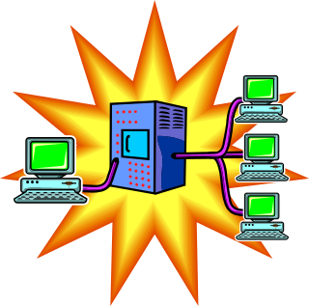
Who Meets Goals?
Effectively manage Portfolio of Projects and Programs
Achieving complex high-level goals will always require the co-operation of many players
Identifying these players, their granularity, roles, and responsibilities are part of ensuring that goals are adequately met
??

Slide 6
How are Goals Met?
Effectively manage Portfolio of Projects and Programs
Know business needs, strategy, past performance, current plans …
Assume programs don’t conflict,
and that past performance is indicator of future
Forecast costs, benefits, and risks to rank each program
Goal is refined into smaller goals, with dependencies, assumptions, etc.
Roles, responsibility, process chosen to meet those goals
Role granularity is also refined e.g. firm → dept → person
Broken assumption or missing goal can destroy overall business benefit!
Re-balance portfolio to top programs at appropriate times

Slide 7
The Ultimate Success Criterion
Effectively manage Portfolio of Projects and Programs
???
Know business needs, strategy, past performance, current plans …
Assume programs don’t conflict,
and that past performance is indicator of future
Forecast costs, benefits, and risks to rank each program
The final success criterion: Do the applications, humans, and processes together meet the goals?
Re-balance portfolio at appropriate times

Slide 8
Hence Goals Need Clear Definition
Effectively manage Portfolio of Projects and Programs
At all times maintain the firm’s top ranked fundable programs within the project portfolio.
Program rank is based on
forecast program value, from plan, actual, and forecast of all projects in that program
it’s overall alignment with firm strategy
it’s minimal dependence on other programs

Slide 9
Outline
What is the Motivation for “Goals”?
Goals Modeling and Refinement
From Goals to Responsibilities, Processes and Actions
Obstacles and Conflicts
Soft Goals
“List” and “Draft” versions of goals models

Slide 10
What is a Goal?
A goal defines something desired by some stakeholders, to be fulfilled by some system that is usually composed of multiple cooperating human, hardware and software agents

Slide 11
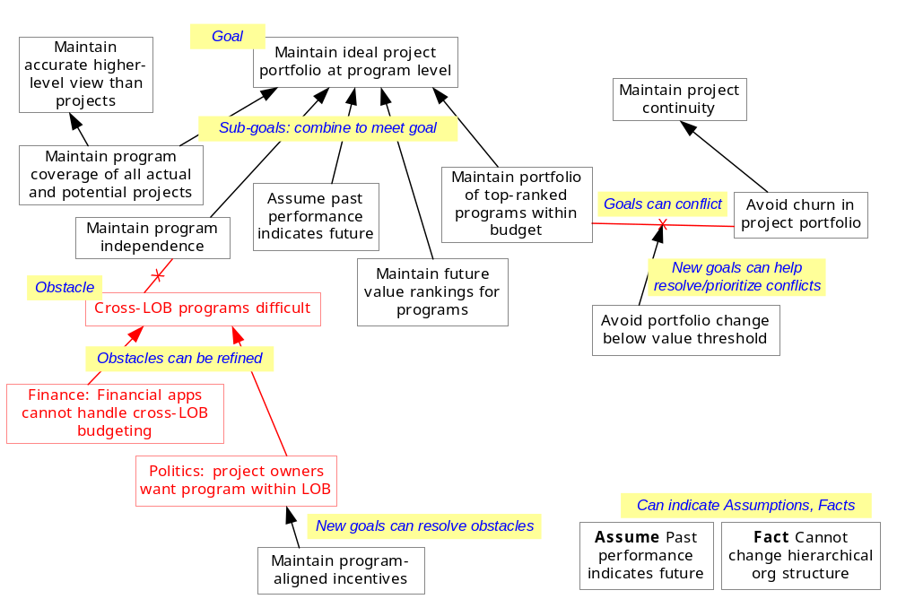
Goals Model: Goals, Refinement, Obstacles
Why
+ text descriptions + information model
How

Slide 12
Goals Modeling Process – Fully Dressed
Find all stakeholders: external roles, users, customers, regulators, marketing, etc.
Identify initial goals: from stakeholders, VOC, pain-points, documentation, etc.
Define each goal clearly; if formalized, use one of the following forms where possible
  Maintain < condition to be maintained >
  Avoid < condition to be maintained >
  Achieve < condition to be achieved >
  Cease < condition to be ceased >
  Min / Max / Optimize < condition to be minimized, maximized, optimized >
Uncover key underlying terms of goals in a glossary or information model
Explore hidden and alternate goals and assumptions, by asking for each goal, G
  Why is G a goal: this will uncover rationale and find a higher-level goal, G1
  How is goal G1 fully realized: this will find sub-goals, assumptions, alternatives to realize G1
Find obstacles to goals, by asking what might keep each goal G from being met
  Address obstacles with changed goals e.g. obstacle prevention, obstacle minimization, goal weakening, etc.
Find conflicting goals and the conditions under which they conflict
  Resolve conflicts by changed goals e.g. prioritize one goal over the other in condition of conflict
Refine goals until “realizable” by process or roles (at chosen level of granularity)
  Goal requires to control something (e.g. portfolio balance) and observe others (e.g. market), to meet certain conditions (e.g. maintain risk/return ratio within targets)
  Goal is “realizable” by process or roles if it can control and observe as required by the goal
  Lower level: use-case goals, pre/post conditions, etc. do not need separate goals model

Slide 13
Main Elements of Goal Modeling – “Dressed”
Goal Model
Why goals exist
How goals are realized
Definition of each goal
Stakeholders, priorities, etc.
Alternative goal realizations
Obstacles, conflicts, resolutions
Stakeholders in Goals
Who are primary stakeholders for each goal
Responsible roles or process has access or
control of attributes and types
as needed for the assigned goals
Some form of accountability
All important terms used in goals
are captured in Information Model
Responsibility Assignment
Which human or other agent is (and can be) responsible for goal
Can explore alternate responsibility assignments
Information Model
Objects, attributes, etc.
The things that would appear on an “executive dashboard” that monitored goal-oriented performance
Light weight “List” and “Draft” versions are equally useful

Slide 14
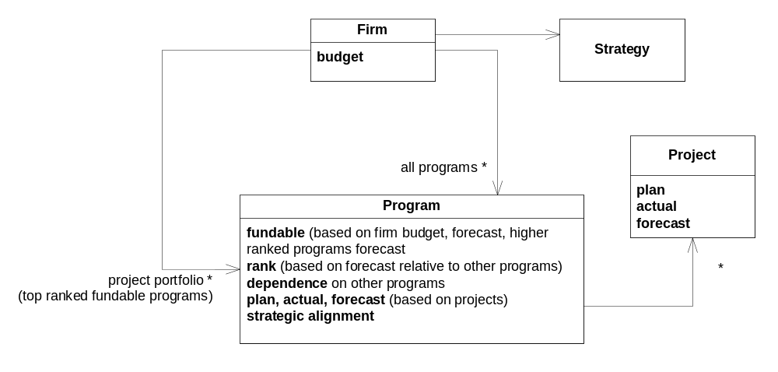
Goals and Information Model
Goal Maintain ideal project portfolio at program level
At all times maintain the firm’s top ranked fundable programs within the project portfolio. Rank is based on
forecast program value, from plan, actual, and forecast of all projects in that program
it’s overall alignment with firm strategy
it’s minimal dependence on other programs
Goals become clearer and fewer, goal structure better motivated

Slide 15
Information Model – Pragmatic Formalization
Ambiguities are inevitable and natural in initial goals definition
  Inherent ambiguity in language, or to deliberately avoid committing too early
  Definition of objects/attributes and the definition of goals themselves
For example, “forecast value of program” could mean
  the value the local sponsor assigns to the program
  a risk-adjusted and present-valued benefit to the entire firm from the program
Missing key definitions makes it very hard to know what is meant
However
  Not all ambiguities need to be solved as soon as they arise
  Solve after further elaboration when you have better understanding of overall issues
Hence
  Start with idealized goals: they are often easier to make clear
  e.g. “always maintain firm-wise optimal risk-adjusted and time-adjusted project portfolio”
  Premature compromises on the ideal makes alternatives and trade-offs impossible

Slide 16
Kinds of Goals
Goal classifications: Achieve, Cease, Maintain, Avoid
  Achieve goals: goals requiring that some property become true
    If Condition is true then State should become true [within some time frame]
  Cease goals: goals requiring that some property will stop being true
    If Condition is true then State should become false [within some time frame]
  Maintain goals: goals requiring that some property remain true
    If Condition is true then State should be maintained always true [until Stop_Condition, within time frame]
  Avoid goals: goals requiring that some property remain false
    If Condition is true then State should never become true [until Stop_Condition, within time frame]
Soft goals
  Somewhat “fuzzy” goals that do not have clear-cut satisfaction criterion
  Optimization goals e.g. Min, Max goals: goals to minimize or maximize some property
  Soft goals are useful to guide and choose between alternative approaches
As we get towards software requirements consider different kinds of requirements
  Functional: use cases, feature sets, capabilities
  Security: access control, non-repudiation
  Usability: human factors, aesthetics, help, documentation and training
  Reliability: frequency and severity of failure, recoverability, predictability, accuracy
  Performance: response time, scalability, throughput
  Supportability: test, extend or adapt, maintain, configure, operate and manage

Slide 17
Scenarios and Goals
Scenarios and goals have complementary characteristics
Scenarios
  concrete examples
  often narrative and procedural in nature
  leave intended properties implicit
Goals
  abstract
  declarative
  make intended properties explicit
Scenarios and goals complement each other
  Scenarios validate and help uncover and clarify goals
  Standard CAM techniques of concrete snapshots and scenarios

Slide 18
Assumptions and Facts
An Assumption is a goal assumed to be satisfied in the domain
A Fact is something known to be true in the problem domain
Assumptions and facts help understand goals and refinement
They should be described only to the extent they are helpful to understand goals, goal refinement, and obstacles

Slide 19
Goal Refinement
A goal may be met by some combination of (smaller) goals
Goal: Maintain Confidentiality of Data
  Goal: Avoid Classified Data Flowing Inappropriately
  Goal: ….
This is called “goal refinement”
Goal refinement requires corresponding information model refinement
  What is classified data? Data: classification
  What is Inappropriate Flow? Component: clearance
  No flow of data to component with lower clearance than data classification

Slide 20
What is a “Good” Goal Refinement?
Formally, a set of goals {G1, ..., Gn} refines a goal G given some domain facts if the refinement is:
  Complete: The sub-goals (with domain facts) do, in fact, meet the goal G
  Minimal: All the sub-goals are necessary to meet the goal G
  Consistent: The sub-goals are consistent with each other and with the domain

Slide 21
[Advanced] Some Goal Refinement Patterns
If a role or process lacks adequate information access to meet a goal
  Add information access
  Split lack of direct access by introducing intermediate information
    Introduce intermediate tracking information + some accuracy goal
    Achieve goals: split into sequence with intermediate state, sub-goals access intermediate state
    Maintain goals: split into sub-goals that maintain the intermediate information
    Split by cases and resolve each case separately
    Replace inaccessible state S by accessible events S_true, S_false
If a role or process lacks adequate information control to meet a goal
  Add information control
  Split lack of direct control by introducing intermediate information
    Introduce new info to control goal + actuation goal
    Similar variations for Achieve, Maintain, etc. goals
If an (ideal) goal involves knowing about the future
  Prediction pattern: sub-goals to predict future, act based on prediction, learn from past
Goal-refinement patterns rationalize the structure of the goal model

Slide 22
Outline
What is the Motivation for “Goals”?
Goals Modeling and Refinement
From Goals to Responsibilities, Processes and Actions
Obstacles and Conflicts
Soft Goals
“List” and “Draft” versions of goals models

Slide 23
Responsibilities
Some object(s) can be made responsible for a goal
Those objects must collaborate (some process) to meet that goal
Refine goals until “realizable” by process or roles (at chosen level of granularity)
Goal: balance the portfolio to maintain expected risk/return ratio while the market changes
A goal requires
  to observe some things (e.g. market)
  to control some thing (e.g. balance of portfolio)
  to meet certain conditions (e.g. maintain risk/return ratio within targets)
A goal is “realizable” by process or roles if it can control and observe as required by the goal
  There will be lower-level collaboration even to “observe” what needs to be observed
  Just utilize use-case goals, pre/post conditions, as appropriate at lower levels

Slide 24
From Goals to Business Processes
Goals uncover the basic information model of the domain and add desired constraints to it
CAM case/case-coordination pattern provides a basis for top level process partitioning
Goals help further define the processes
  Identify what activities are needed in the processes
  Properly specify those activities e.g. this activity
    trigger: must be performed whenever: …
    prohibit: must not be performed unless: …
    post: must result in: …

Slide 25
Deriving Specifications of Actions from Goals
e.g. for a goal: Maintain [while condition then state]
  Op 1 to establish state must be performed whenever condition becomes true
  Any Op 2 that exits state must not happen unless condition was false
e.g. for a goal: Achieve [when condition then state change]
  Op 1 to establish state change must be performed whenever condition becomes true
Hence processes must observe the rules required to meet such goals
Finer analysis possible by making finer-grained distinction of goal types
  state invariants vs. transition invariants
  invariant that hold over all system states, or only after or between some conditions
A goal influences many actions; an action is influenced by many goals
  Formally one might distinguish domain facts from goal-derived pre/post
One can make reasoned argument about meeting goals

Slide 26
Outline
What is the Motivation for “Goals”?
Goals Modeling and Refinement
From Goals to Responsibilities, Processes, and Actions
Obstacles and Conflicts
Soft Goals
“List” and “Draft” versions of goals models

Slide 27
Obstacle Definition
An obstacle is a high level “Exception”
  It defines a set of undesirable behaviors of a system
  Obstacles are so because they can prevent goals from being met
O is an obstacle to a goal G if
  O is sufficient (combined with domain facts) to prevent G from being met
Obstacle modeling addresses “early-phase” goals
  over-idealization and initial simplistic assumptions
  lack of anticipation of exceptions or possible modes of failure
  incorrect assumptions about humans or machines, …
Set of obstacles O1, O2, … On is complete with respect to goal G if
  … whenever all the obstacles in the set are avoided
  … based on the domain properties
  … you are guaranteed that goal G is met
Other obstacle analysis can be useful, depending on domain
  Likelihood of obstacle (e.g. Possible, Impossible, numerical), cost to accept/fix
  Such properties can be propagated through goals/obstacle model e.g. attack trees

Slide 28
How to find Obstacles
Find the “Pain Points” e.g. from VOC interviews
Ask “Why is this a problem” to find obstacle and goal description
Negate goal or some part (usually only the lower-level goals)
Refine the negation (for obstacles considered likely or high risk)
Obstacle O to goal G
  frequently refined into sub-obstacle O1 to sub-goal G1
Focus on obstacles to leaf goals assignable to agents
Focus on obstacles to high-priority, security, and safety goals; in general, some domain-specific cost-benefit analysis is needed
Quit obstacle analysis when leaving unresolved is acceptable

Slide 29
Obstacles and Resolution
Obstacles prevent goals from being met
Obstacles have to be addressed in some way
  Eliminate obstacle: e.g.
    devise alternative refinement of higher-level goal
    add new goal to specifically avoid the obstacle
  Weaken or de-idealize the goal
    Simply change from too ideal to more realistic goal definition
  Obstacle reduction e.g.
    human incentives
    self-correcting designs
  Obstacle mitigation e.g.
    allow obstacle to occur and introduce a new goal to mitigate its effect

Slide 30
Conflicts between Goals
Start with ideal goals
Some goals may conflict under some “boundary conditions”
Goals that share parts of the information model can conflict
Mark important conflicts on the model, annotated with conditions
Resolve conflicts e.g. by prioritizing one goal over the other, or introducing new goals to resolve the conflict

Slide 31
Cause and Effects Diagram → Goals Model Equivalent
Methods
Machine
People
Sorter Malfunctions
Delivered to wrong Address
Delivers to wrong house
Different Route
Power Outages
Delivers wrong package
Sorted Incorrectly
Truck Breakdown
Sender enters from address information
Mail is late
Wrong postage
Bad Weather
Wrong to or from address written on package
Sick Days
Volume of Mail
Measurements
Mother Nature
Materials
Goal = on time mail
  goal refinement = right address, delivery, power, weather, …
Obstacle = late mail
  obstacle refinement = goals and obstacles, sub-obstacles obstructing sub-goals

Slide 32
Outline
What is the Motivation for “Goals”?
Goals Modeling and Refinement
From Goals to Responsibilities, Processes and Actions
Obstacles and Conflicts
Soft Goals
“List” and “Draft” versions of goals models

Slide 33
Soft Goals and Alternative Designs
Soft goals are …
  Somewhat “fuzzy” goals that do not have clear-cut satisfaction criterion
  e.g. Optimization goals e.g. Min, Max goals minimize or maximize some property
Soft goals can help guide choice between alternative solution approaches and architectural choices
Min/Max Goals naming
  Min <Property to minimize>
  Max <Property to maximize>
Can add qualitative annotation to goal structure graph
  +++, ++, + (degree of support for goal)
  ---, --, - (degree of conflict with goal)
  etc.
Soft Goal 1
+++
option B
Soft goal 2
Soft goal 3

Slide 34
Outline
What is the Motivation for “Goals”?
Goals Modeling and Refinement
From Goals to Responsibilities, Processes and Actions
Obstacles and Conflicts
Soft Goals
“List” and “Draft” versions of goals models

Slide 35
Goals – summary tabular version
The element named
Described as
[Optional]
Is the responsibility of
[some may be marked Out of Scope]
[Optional]
Conflicts, obstructs, is obstructed by, or resolves
[Optional]
Variability
[Optional]
Stakeholders [optionally with stakeholder view of goal]
[Optional]
Priority
Goal
<name>
<description>
<how variable or negotiable is this item>
Goal
<name>
<description>
Obstacle
<name>
<which goals does it obstruct>
Assumption
<name>
Fact
<name>
Gap
<name>

Slide 36
Goals – detailed tabular version
Goal ID
Goal
Date
B1.0
Maintain optimal project portfolio at program level
1/2/03
Description
Always maintain an optimal mix of top-ranked fundable programs in the project portfolio, where ranking is determined by (planned, actual, and forecast) business value, costs, risks, and inter-program dependencies, all derived from project-level intra-program information.
Sub-Goals
<Goal 1>
<Goal 2>
If needed, an explanation of how sub-goals combine.
Obstacles
<Obstacle 1>
<Obstacle 2>
Responsibility of Role/Process
Stakeholder
Owner
Variability
Parent Goal(s)
Priority

Slide 37
Information Model – detailed tabular version
Order
Data associated with an instruction from an investor, to either buy or sell an instrument according to certain parameters conveyed with the instruction.
Aliases: None.
Supertypes: None.
buyOrSell
{buy, sell}
Indicator to show whether the order is to buy or sell the instrument.
Rule: <any rule or constraint applicable to this attribute, or combinations of attributes>
quantity
Integer
Quantity of the instrument to buy or sell.
price
Currency
Overall price for the order, as figured, and eventually approved, by the Trader.
instrument
Instrument
The instrument to be bought or sold.
trades
Set of Trades
All trades that fulfill the Order

